Slide 1
Buccaneer Presentation
By Mathew Jones[maj56] & Jake McDonagh[jam93]
Robert Buchan Terrey[rob27]

Slide 2
Brief Introduction
The following presentation consists of two parts:
The first part uses hyperlinks to demonstrate how the system will most likely function for the final version of this product. As well as this, the slides will give information in regards to the use cases in the User Interface Specification.
The second part will go through the main scenarios that will take place in a usual game of Buccaneer. Like in the first part, the slides will give information that will detail how the system works in regards to the use cases.
NOTE: The graphical fidelity of the system is still a work in progress and is therefore not the final version. The presentation’s main purpose is to give an accurate representation of the interactivity, not the look.

Slide 3
Waddington's
Buccaneer
Clicking the “Rules” button in order to go the Rules page [U02]
Clicking the “Credits” button to take us to the Credits screen [U03]
Clicking the “Start Game” button to set up the game [U04]
Clicking the “Exit” button in order to go the Rules page [U20]
Start Game
Rules
Credits
Exit

Slide 4
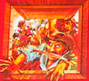
RULES
Crew Strength
Movement speed = Total number on cards
Fighting strength = Range of red-black cards
Movement
Must move in a straight line to the maximum sailing strength.
Able to the boat to face a new direction at the end of turn.
A player who losses all their crew cards may move one space at a time.
Clicking the “Return to Menu” button, allowing the user to return to the main menu [U01]
Fighting
If more than one player is on the same square, either player can declare an attack.
The players fighting strength will be shown on the screen.
The winner is able to chose a maximum of two treasures.
If the winner does not have enough space they receive the two lowest crew cards.
The loser is then forced to move to their maximum sailing strength away from the winner.
If it’s a draw then the attacked player gets a free move to move away from the attacker.
Return to menu

Slide 5
Player Information
Player 1
enter players name
Players’ names are entered into the four textboxes to the left with the purpose of being able to uniquely identify each player in a user friendly manner
Player 2
enter players name
Player 3
enter players name
Player 4
enter players name
Clicking the “Return to Menu” button, allowing the user to return to the main menu [U01]
Clicking the “Play Game” button will take us to the main game screen, proceeding the state of the game [U05]
Return to menu
Play Game

Slide 6
Player Information
Player 1
foo
Player 2
bar
Player 3
baz
Player 4
qux
Return to menu
Play Game

Slide 7
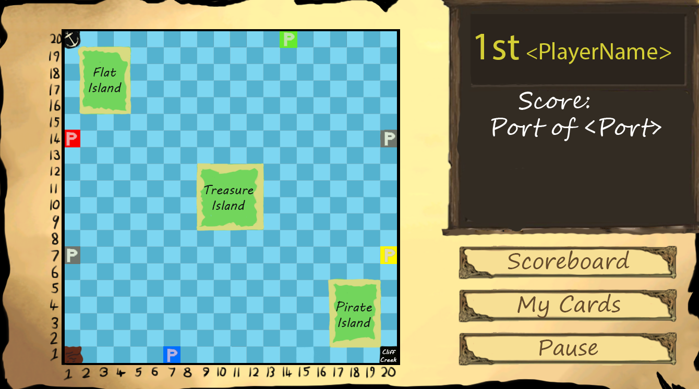
Game Screen – Interface Basics

Slide 8
Game Screen – Interface Basics
The user’s are able to interact with each of the islands in a different manner (Can acquire treasure from Flat Island, can draw chance cards from Treasure Island and acquire crew from Pirate Island
The red, blue, yellow and green spaces represents the player ports (which are each owned by one of the respective users) whilst the grey spaces are the Trading Harbors that aren’t owned by anyone.
The spaces in each corner of the map (with the exception of 20, 20) Are important spaces that are affected by chance cards.

Slide 9
Game Screen – Interface Basics
The right will display basic information about the current user, such as the position that they’re in (1st, 2nd, 3rd or 4th) as well as their current score, the name of their port as well as the crew cards that they’re currently holding
The “Scoreboard” button will take the user to the scoreboard screen that shows the overall statistics of each player [U15] whilst the “My Cards” button will take the user to a new screen showing his cards in detail [U11]. Finally, the “Pause” button sets the game to state.pause [U07}
Once you are ready to proceed to the different scenarios that will play out in a typical Buccaneer game, click here

Slide 10
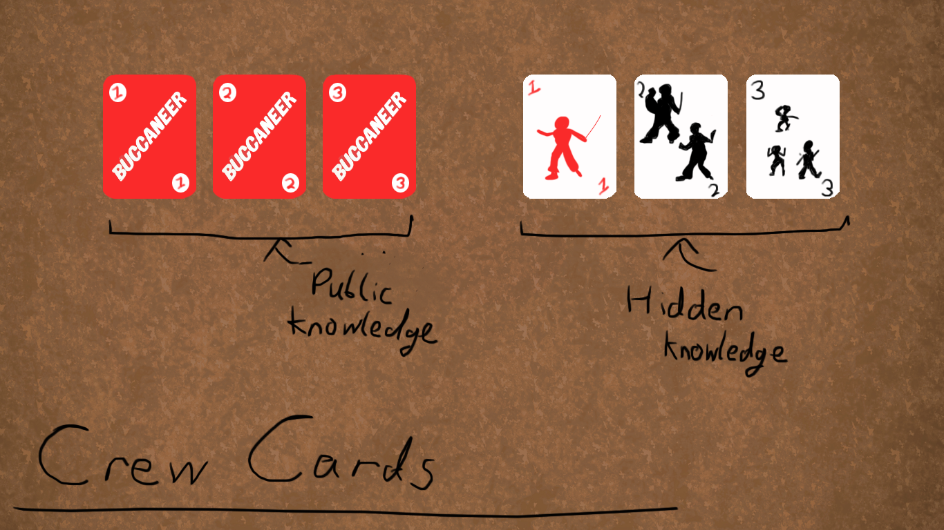
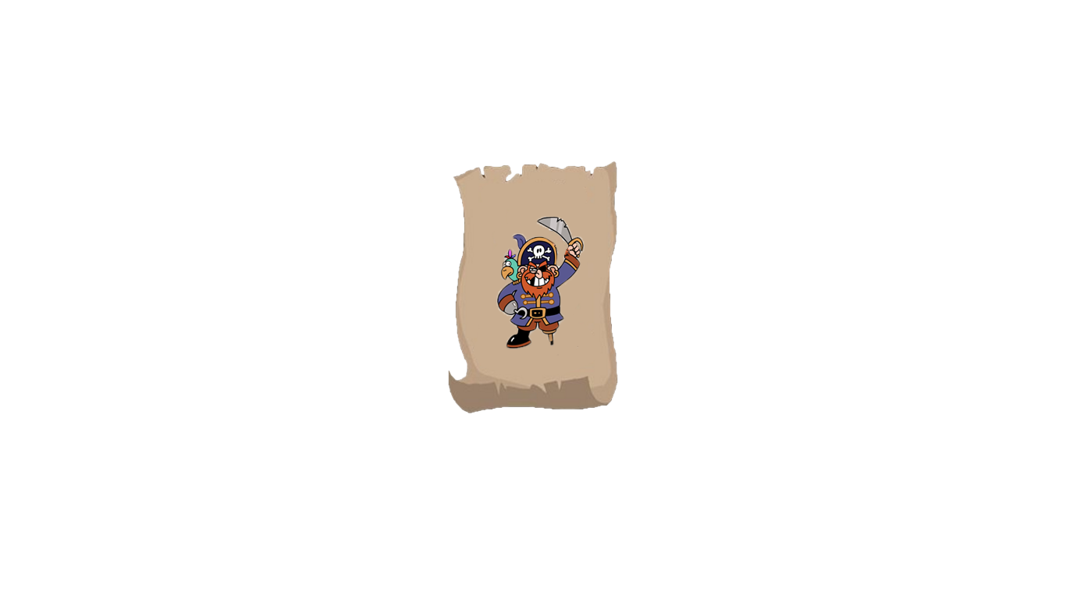
U15
ScoreBoard
This screen provides the users with the basic information about all of the players in the game session. The boxes contain information about the player’s name, what port they belong to as well as the treasures in said port as well as the crew/chance cards that they hold. The boxes are colour coded in respect to the colours of their ships and port
Player 1 Foo
Player 2 <NAME>
Player 3 <NAME>
Player 4 <NAME>
Score: 12
Score:
Score:
Score:
Crew Movement Speed: 6
Treasures on Ship:
Port of Genoa
Port of Marsielles
Port of Cadiz
X 2
X 3
X 1
X 1
X 2
X 2
X 5
X2
X 4
X 3
X 3
X 3
X 2
X 2
X 4
X 3
Clicking the “Return to menu” button will take the user back to the main game screen from the last point which the game state is at [U06]
Return to menu

Slide 11
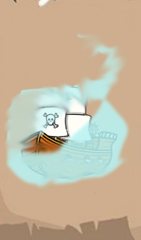
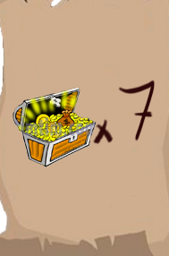


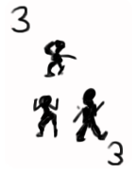

My Cards
Player 1 <NAME>
Score:
Port of London
This is a graphical representation of all
The users details.
X 3
X 1
X 2
X 4
X 5
Ship treasure:
X 1
Crew cards/Chance cards
Return to game

Slide 12
Buccaneer Scenarios
Scenario 1 – Ending the turn & starting a new one [U06a]

Slide 13
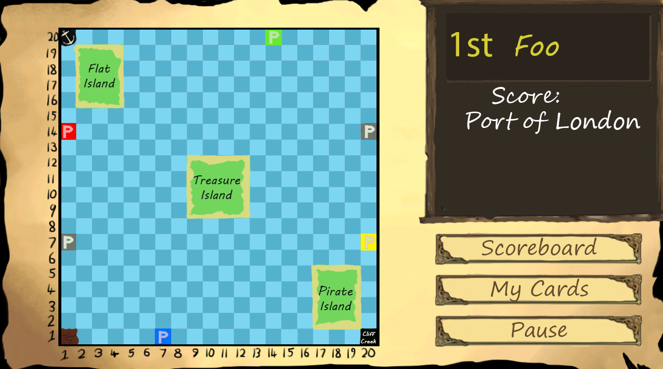
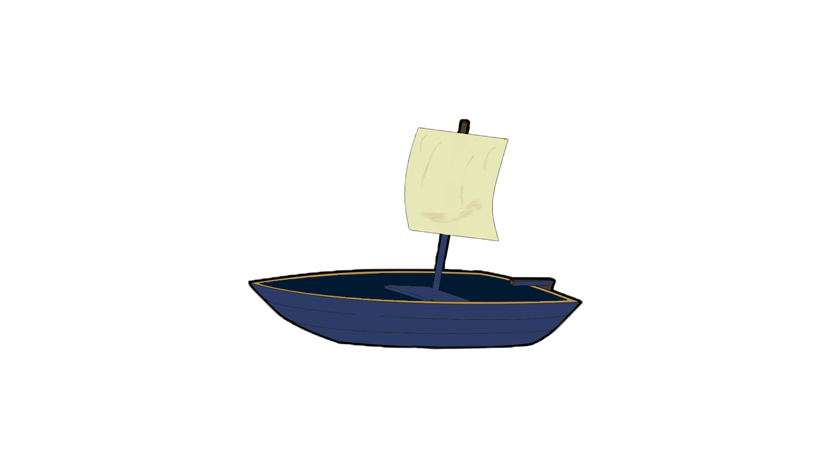
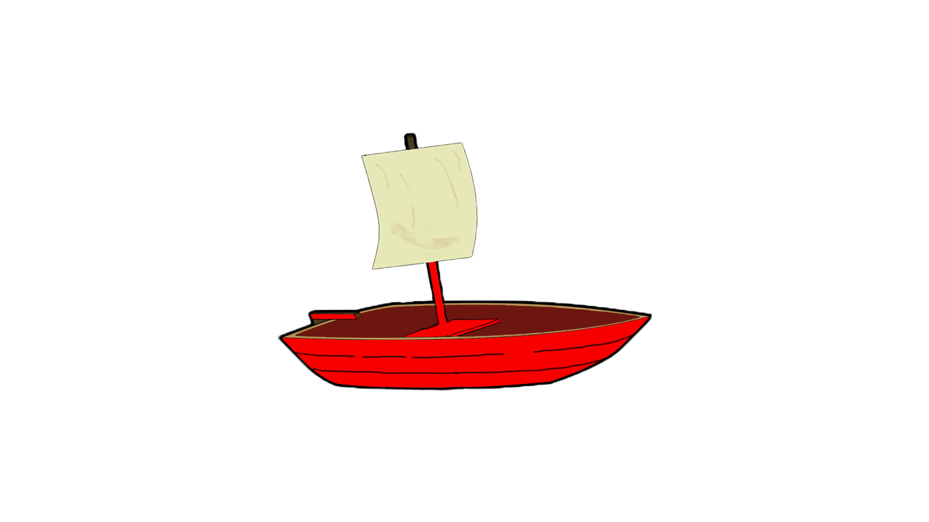
Once the user has selected the direction which they would like to face, the screen will darken to signal that it is the next player’s turn.

Slide 14

Next Player
Player 2 Bar
Start!
Ok

Slide 15
Buccaneer Scenarios
Scenario 2 – Ship Movement [U06b]

Slide 16

In this scenario, it is Foo’s turn. Foo controls the Port of London, and thus is also in control of the red boat. The total crew movement speed of Foo is 5, so Foo is able to move 5 spaces in a straight line in front of them.

Slide 17
By clicking on one of the legal squares, the ship will be able to move to said square. In this example, the ship would move to position (6, 12) after clicking on the respective square

Slide 19
Buccaneer Scenarios
Scenario 3 – Turning the Ship[U09]

Slide 20
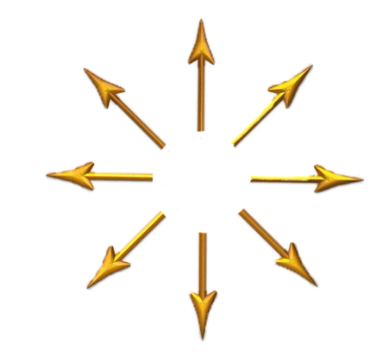
Once the ship has moved, a compass will appear around the ship, allowing the player to change the direction of their ship at the end of the turn.

Slide 21
In this case, once the user has selected the down arrow on the compass, the boat will point downwards to signal that it has worked.

Slide 22
Buccaneer Scenarios
Scenario 4 – Receiving information from objects on board [U05 – State.game]

Slide 23
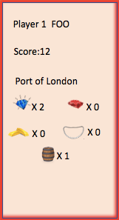
12
As the user hovers the mouse over the port, the user receives all of the necessary information about the specific port selected. In this case, Foo’s port is selected.

Slide 24
Treasure Island
Available Treasure
X 3
X 1
Also holds chance cards.
And in this case, when the user selects one of the islands the game will present the information about the respective island.

Slide 25
Buccaneer Scenarios
Scenario 5 – Arriving at home port [U13]

Slide 26
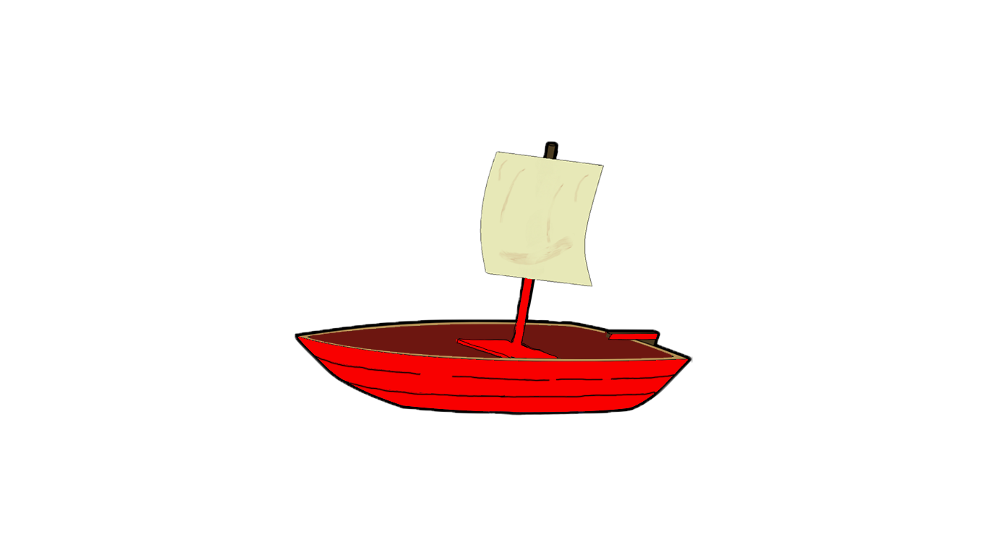
When a ship gets to its own port a pop up appears

Slide 27

Treasure Transferred to port
x 1
x 1
Ok

Slide 28
Buccaneer Scenarios
Scenario 6 – Ending the turn & starting a new one [U06a]

Slide 29
Once the user has selected the direction which they would like to face, the screen will darken to signal that it is the next player’s turn.

Slide 30
Player 2 Bar
Start!
Ok

Slide 31
Buccaneer Scenarios
Scenario 7 – Attacking Other Ships [U10]

Slide 32
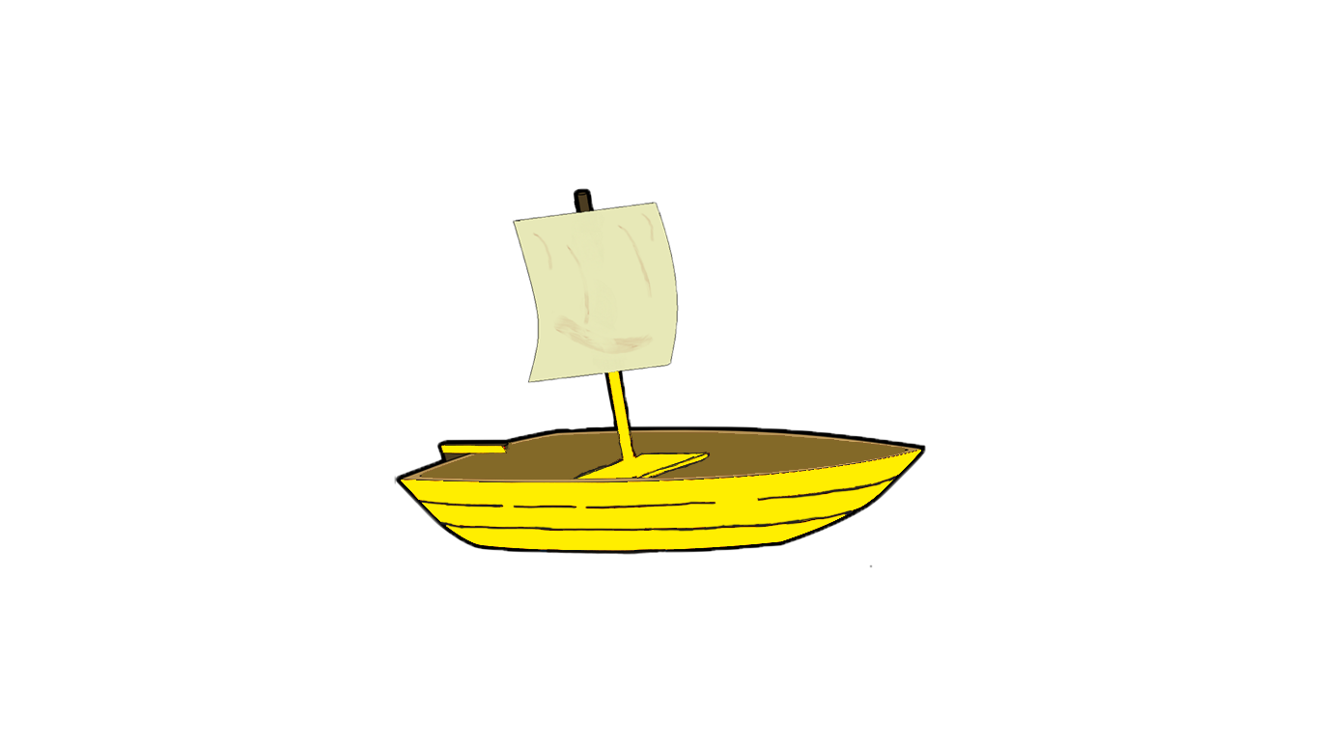
If the through ship decides not to attack then the standing ship will have the option to attack or NOT.
when a player is passing through another's ship they will be presented with a pop up, displaying their current fighting strength and if they wish to attack that player
when a player is passing through another's ship they will be presented with a pop up, displaying their current fighting strength and if they wish to attack that player

Slide 33
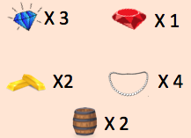
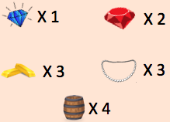

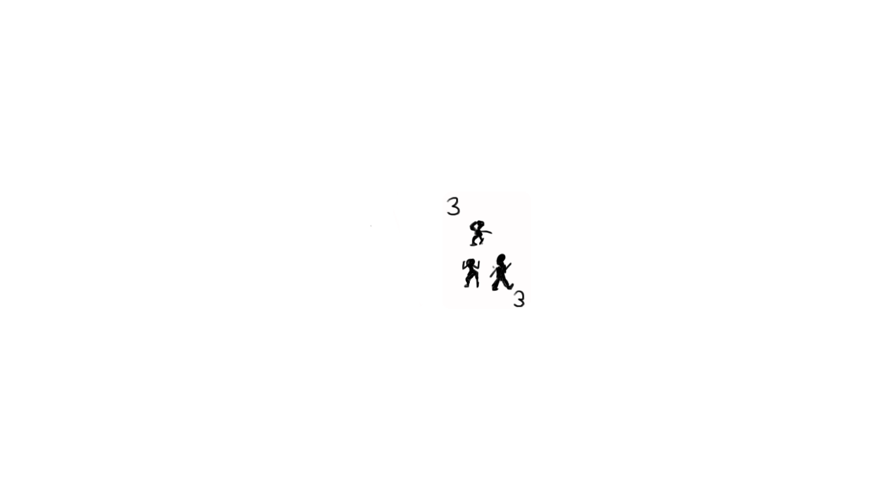

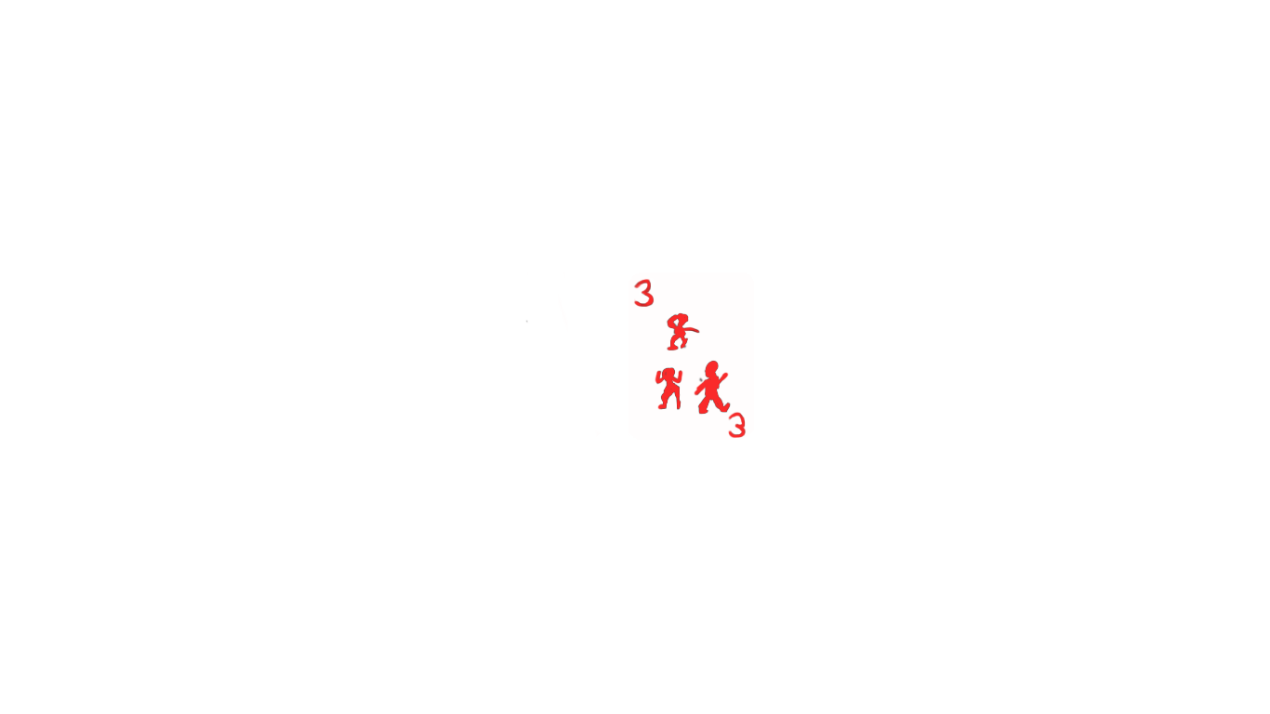



Player 2 Bar
Score:
Port of Genoa
Ship content:
Player 3 Baz
Score:
Port of Marsellias
Ship content:
If the through ship decides not to attack then the standing ship will have the option to attack or NOT.
when a player is passing through another's ship they will be presented with a pop up, displaying their current fighting strength and if they wish to attack that player
when a player is passing through another's ship they will be presented with a pop up, displaying their current fighting strength and if they wish to attack that player
Player 2 would you like to attack player 3 ?
Yes
No

Slide 34
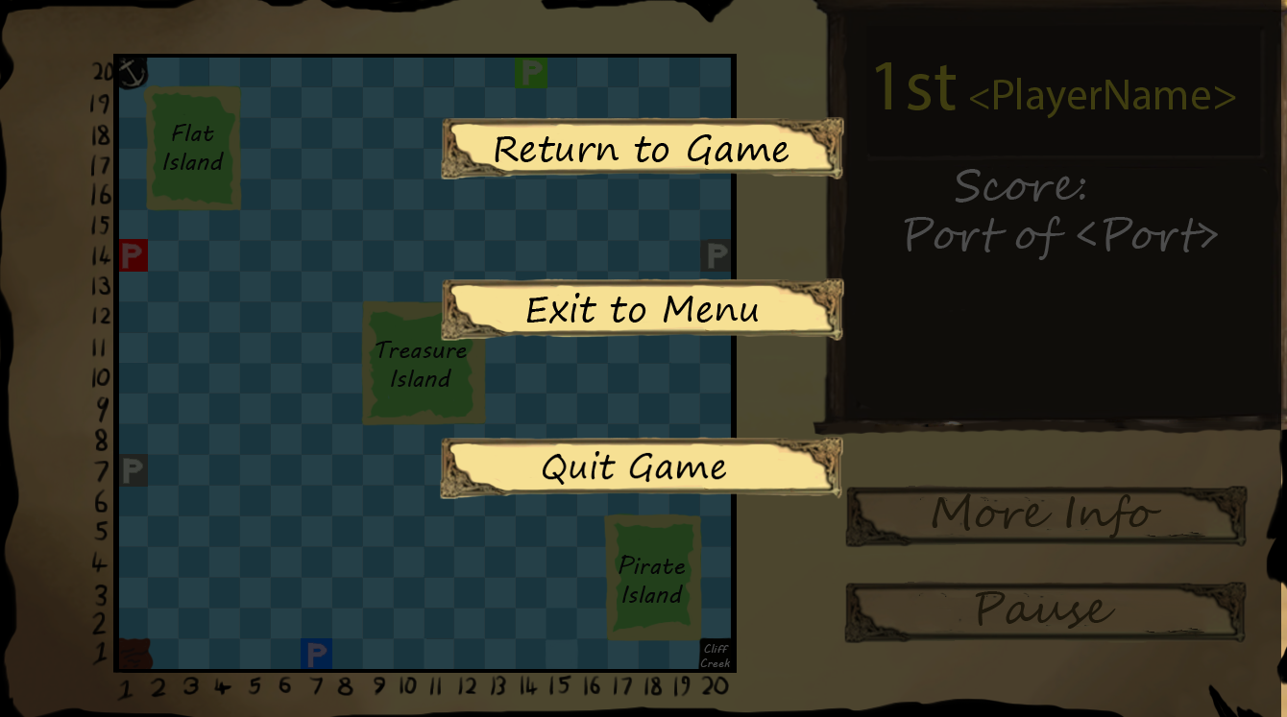

Slide 35
Buccaneer Scenarios
Scenario 8 – Arriving at a foreign port [U14]

Slide 36
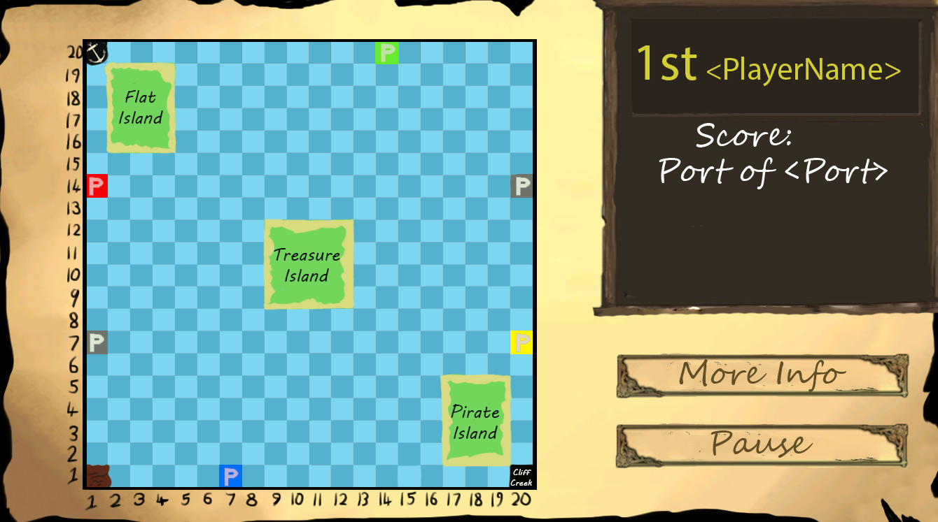
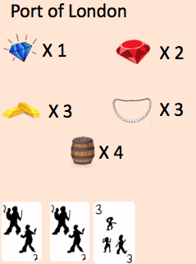
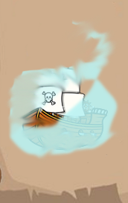
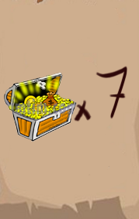
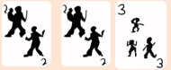


Arriving at foreign Port
Player1 <NAME>
Score:
Ship Stock:
Player3 <NAME>
Score:
X 1

Slide 37
Arriving at foreign Port
Player1 <NAME>
Score:
Ship Stock:
Player3 <NAME>
Score:
Trading with Port <Port>
Your Items to
Trade
x1
Your crew cards to trade
Your Chance cards to trade are
x1
Port Items to
Trade
x1
x3
x4
Your crew cards to trade
X 1
x2
x3
Trade

Slide 38
Arriving at foreign Port
Player1 <NAME>
Score:
Ship Stock:
Player3 <NAME>
Score:
Trading with Port <Port>
Your Items to
Trade
x1
Your crew cards to trade
Your Chance cards to trade are
x1
This port has no tradable items
X 1
Trade not possible
Return

Slide 39
Buccaneer Scenarios
Scenario 9 – Reaching Treasure Island [U12]

Slide 40
Once one of the users’ ships is adjacent for one of the tiles by Treasure Island, the screen will darker as the user draws a chance card.

Slide 41
From drawing a chance card at Treasure Island, you have found…
Long John Silver!
You may exchange Long John Silver for crew cards up to 5 points in value at any port that has crew for sale. You may buy him for one treasure to the port.

Slide 42
Buccaneer Scenarios
Scenario 10 –Chance card [U16]
Long john silver only - currently

Slide 43
NOTE: Because Long John Silver is a type of chance card that stays with the user, it is added to the user’s information along with the rest of their crew cards
After the chance card’s effects have been applied, the user then is allowed to rotate their ship before the end of the turn.

Slide 44
Buccaneer Scenarios
Scenario 11 – Islands[U17/18/19]

Slide 45
Anchor Bay
Treasure
x2
OK

Slide 46
Pirate Island
OK

Slide 47

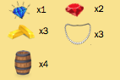

Game Screen – Interface Basics
Flat Island

Slide 48
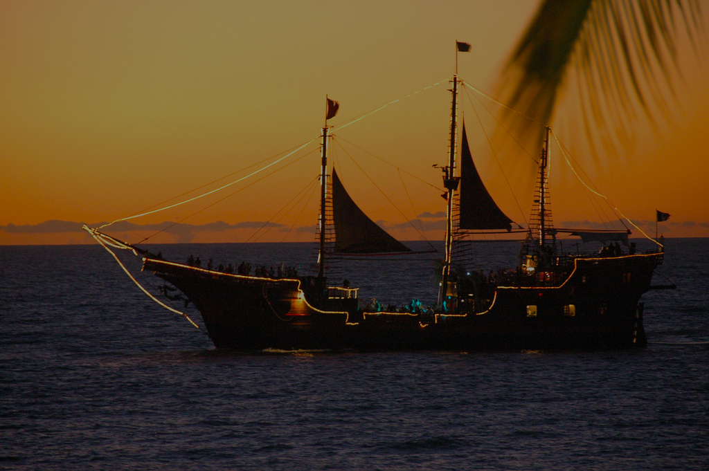
Waddington's
Buccaneer
Are you sure you want to quit the game?
Yes
No

Slide 49
Credits
Robert Buchan Terrey (rob27@aber.ac.uk)
Kamil Cupial (kac12@aber.ac.uk)
Jake McDonagh (jam93@aber.ac.uk)
Julia Wojciechowska (juw30@aber.ac.uk)
Mathew Jones (maj56@aber.ac.uk)
Dominique Parr (dop2@aber.ac.uk)
Harry Adams (haa12@aber.ac.uk)
Clicking the “Return to Menu” button, allowing the user to return to the main menu [U01]
Return to menu

Slide 50
Thanks for playing!
See you soon!

Slide 51
GAME OVER
Bar you’re the winner with 20 pts
Would you like to restart the game
Yes
No

